Slide 1
Neural Language modeling
FMNLP, Fall 1401
Yadollah Yaghoobzadeh
University of Tehran
Most slides are take from Umass CS685 (https://people.cs.umass.edu/~miyyer/cs685/)

Slide 2
CA 1
Today the first CA will be posted.
You have 10 days to submit your solution.
For all of your CAs, you have 5 grace days for the late submission. Once you reach the 5 days limit, we will accept your submission.

Slide 3
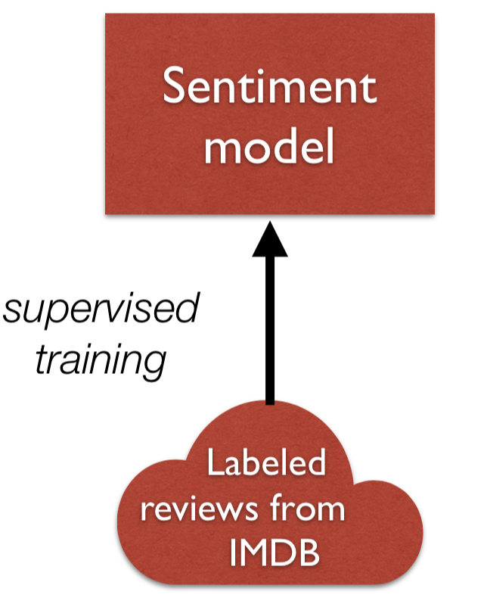
Let’s say I want to train a model for sentiment analysis
In the past, I would simply train a supervised model on labeled sentiment examples (i.e., review text / score pairs from IMDB)

Slide 4
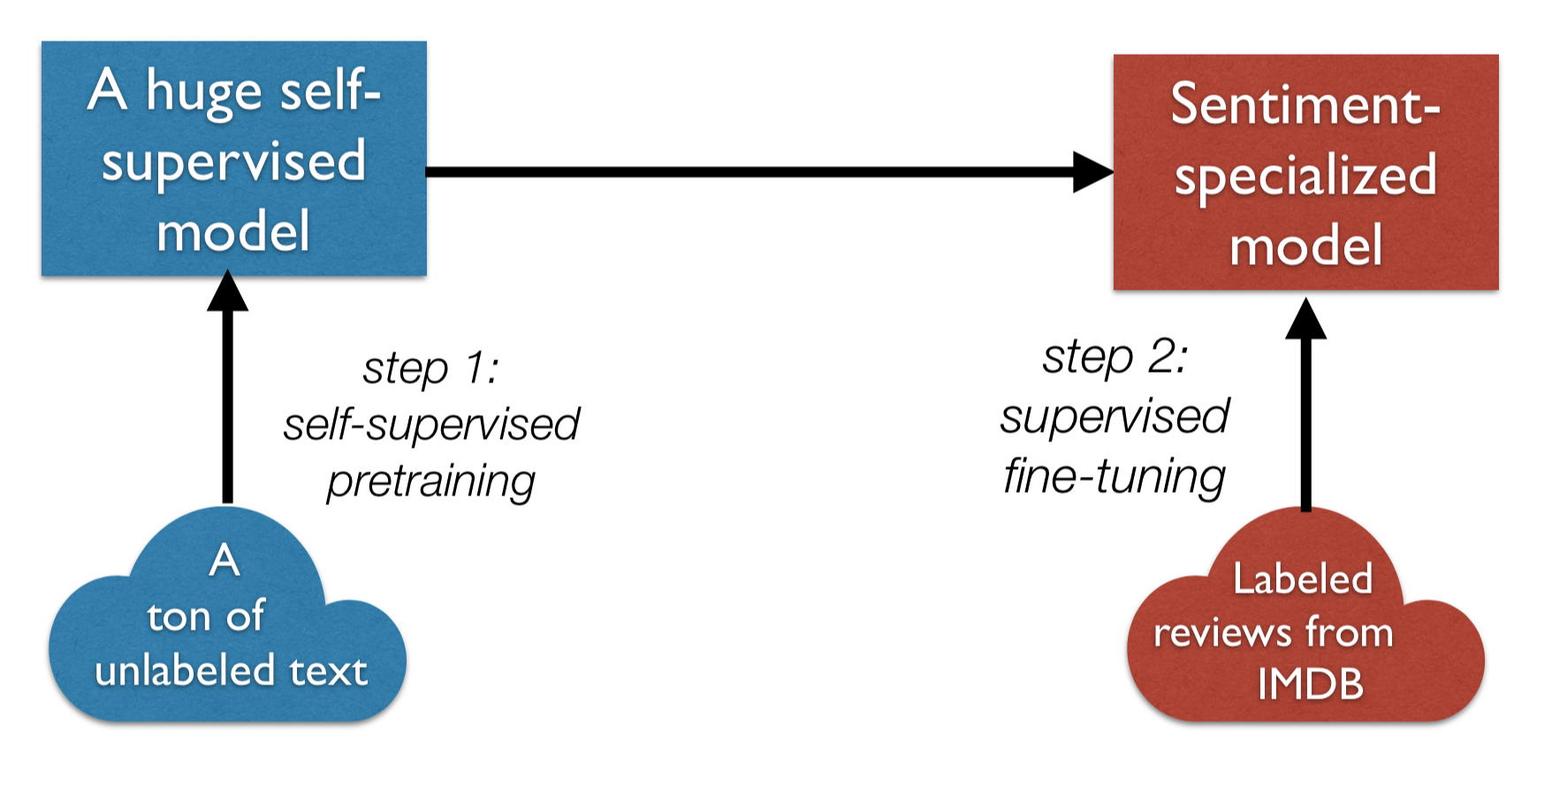
Let’s say I want to train a model for sentiment analysis
Nowadays, however, we use transfer learning:

Slide 5
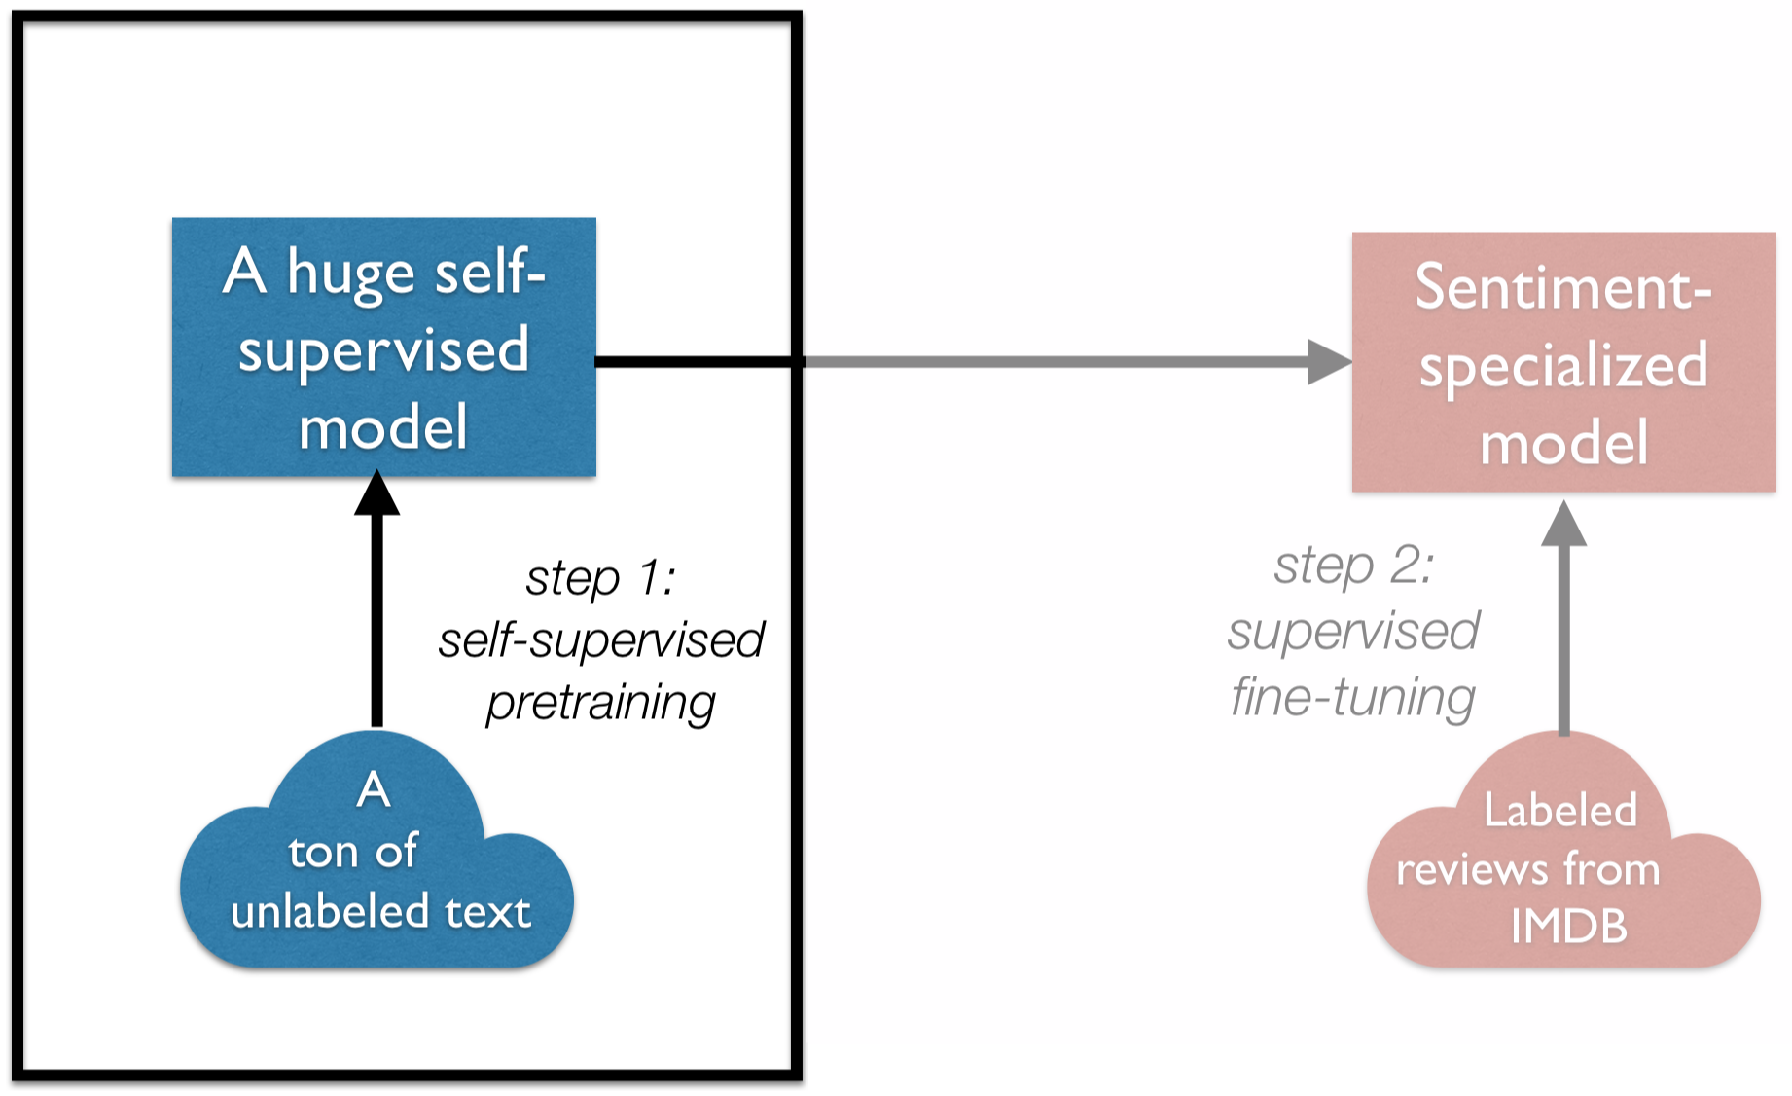
This lecture: language modeling, which forms the core of most self-supervised NLP approaches

Slide 6
Language models assign a probability to a piece of text
Why would we ever want to do this?
Translation:
P(i flew to the movies) <<<<< P(i went to the movies)
speech recognition:
P(i saw a van) >>>>> P(eyes awe of an)

Slide 7
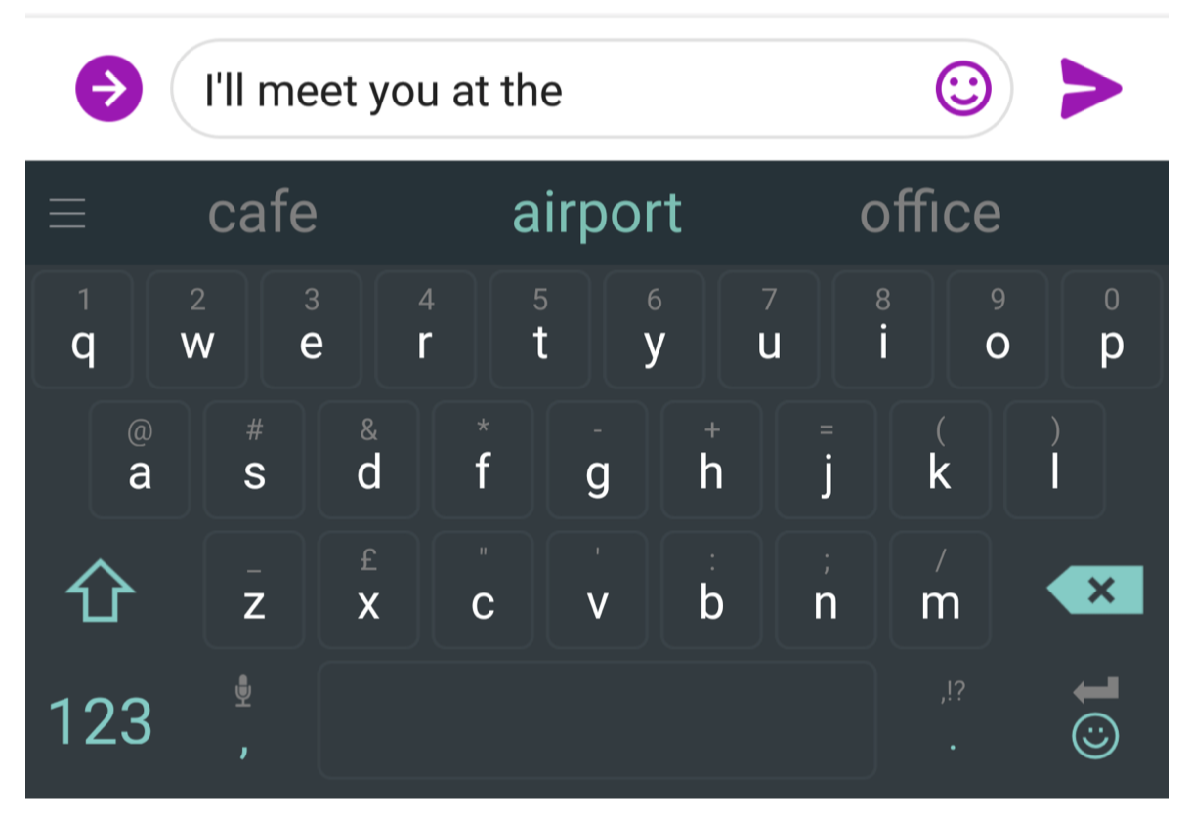
You use Language Models every day!

Slide 8

You use Language Models every day!

Slide 9
Probabilistic Language Modeling
Goal: compute the probability of a sentence or sequence of words:
P(W) = P(w₁,w₂,w₃,w₄,w₅...w_{n})
Related task: probability of an upcoming word: P(w5|w1,w2,w3,w4)
A model that computes either of these: P(W) or P(w_{n}|w₁,w₂...w_{n-1}) is called a language model or LM
We can compute the joint probability using the chain rule:
P(x1,x2,x3,...,xn) = P(x1)P(x2|x1)P(x3|x1,x2)...P(xn|x1,...,xn-1)

Slide 10
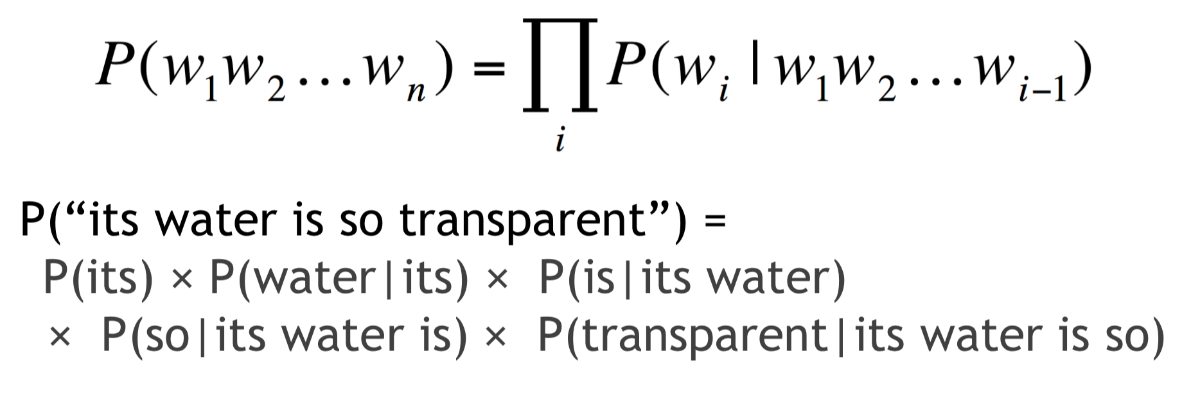
Probabilistic Language Modeling

Slide 11
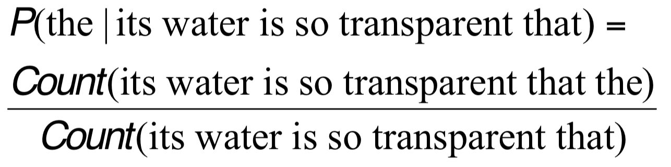
How to estimate these probabilities
Could we just count and divide?
No! Too many possible sentences!
We’ll never see enough data for estimating these

Slide 12
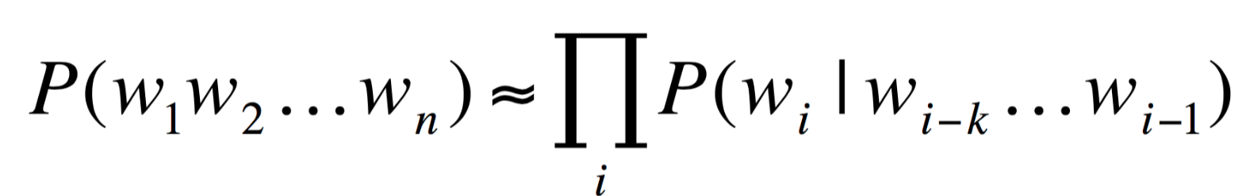
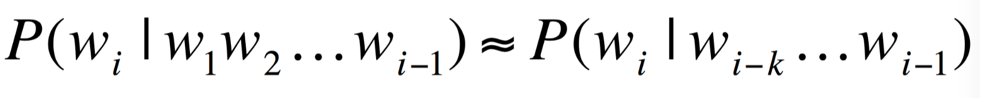
Markov Assumption
In other words, we approximate each component in the product

Slide 13
N-gram models
K is N in the N-gram
We can have unigram, bigram trigrams, 4-grams, 5-grams
But in general this is an insufficient model of language
because language has long-distance dependencies:
“The computer which I had just put into the server room on the fifth floor crashed.”

Slide 14
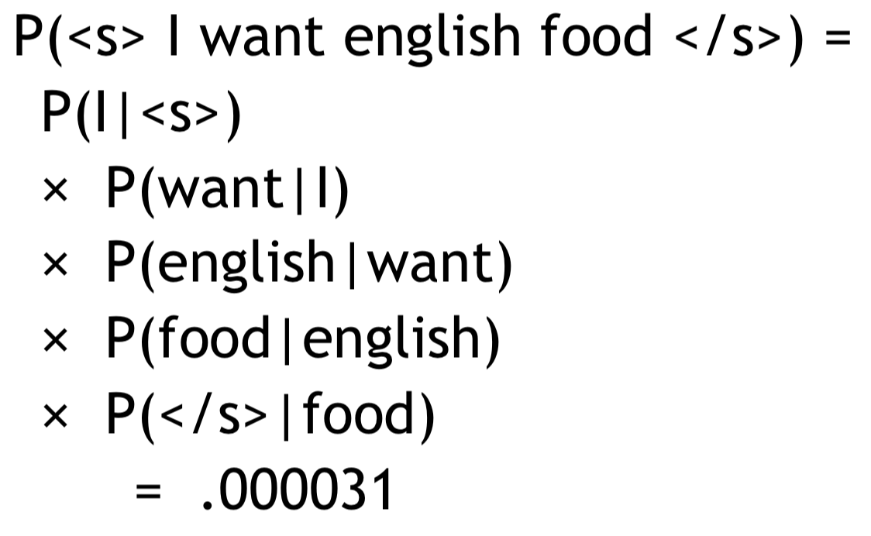
Bigram estimates of sentence probabilities
these probabilities get super tiny when we have longer inputs w/ more infrequent words... how can we get around this?

Slide 15
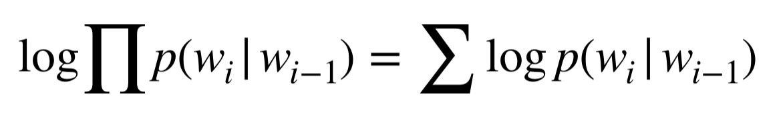
Logs to avoid underflow

Slide 16
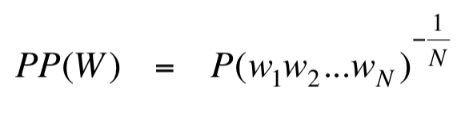
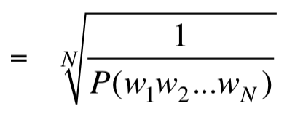
Evaluation using perplexity
The best language model is one that best predicts an unseen test set.
Gives the highest P(sentence)
Perplexity is the inverse probability of the test set, normalized by the number of words:
Minimizing perplexity is the same as maximizing probability

Slide 17
Language modeling review
Goal: compute the probability of a sentence or sequence of words:
P(W) = P(w₁,w₂,w₃,w₄,w₅...w_{n})
Related task: probability of an upcoming word: P(w5|w1,w2,w3,w4)
A model that computes either of these: P(W) or P(w_{n}|w₁,w₂...w_{n-1}) is called a language model or LM
We can compute the joint probability using the chain rule:
P(x1,x2,x3,...,xn) = P(x1)P(x2|x1)P(x3|x1,x2)...P(xn|x1,...,xn-1)

Slide 18
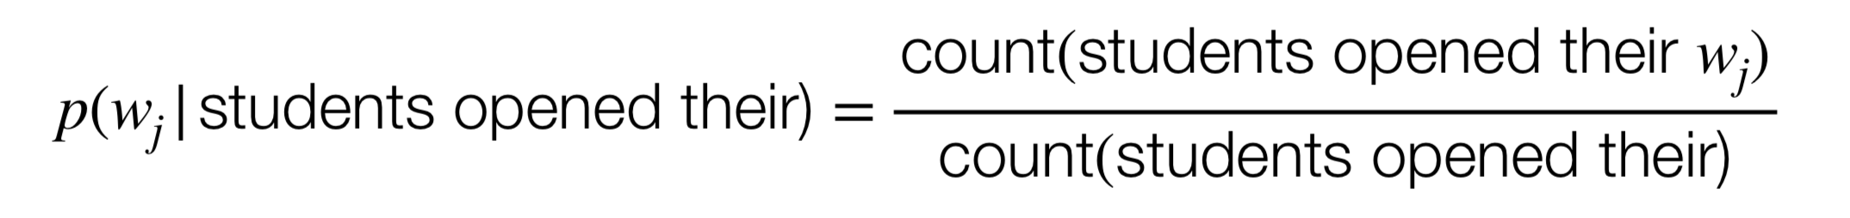
N-gram models

Slide 19
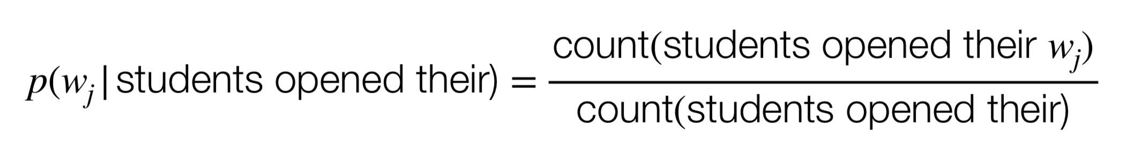
Problems with n-gram Language Models
Sparsity problem
Problem: what if “students opened their w_{j}“ never occurred in data?
w_{j} will have zero probability.

Slide 20
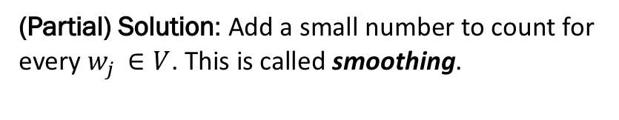
Problems with n-gram Language Models
Sparsity problem
Problem: what if “students opened their w_{j}“ never occurred in data?
w_{j} will have zero probability.
(Partial) Solution: Add a small number to count for every $w_{j }∈V$. This is called smoothing.

Slide 21
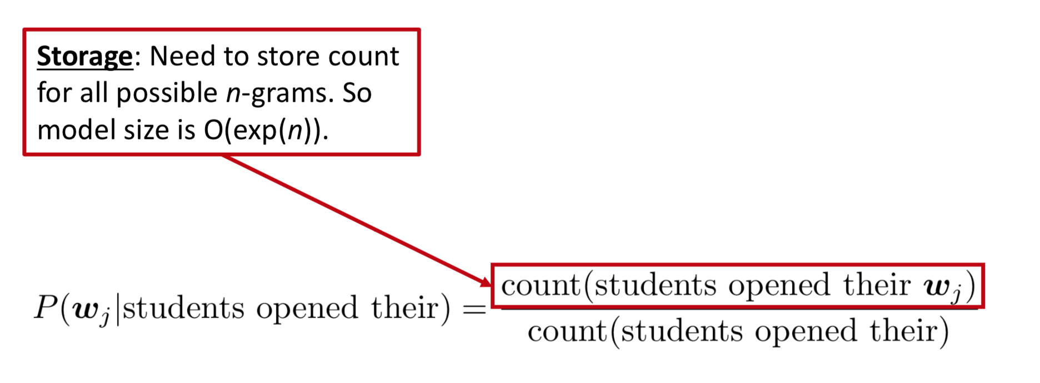
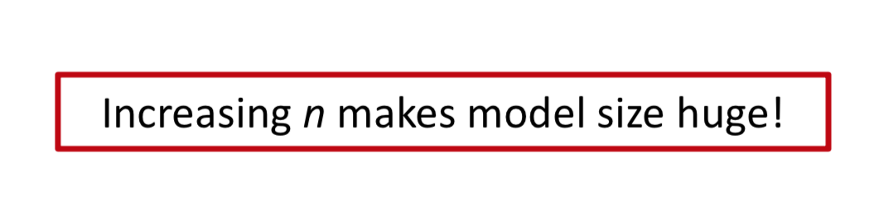
Problems with n-gram Language Models

Slide 22
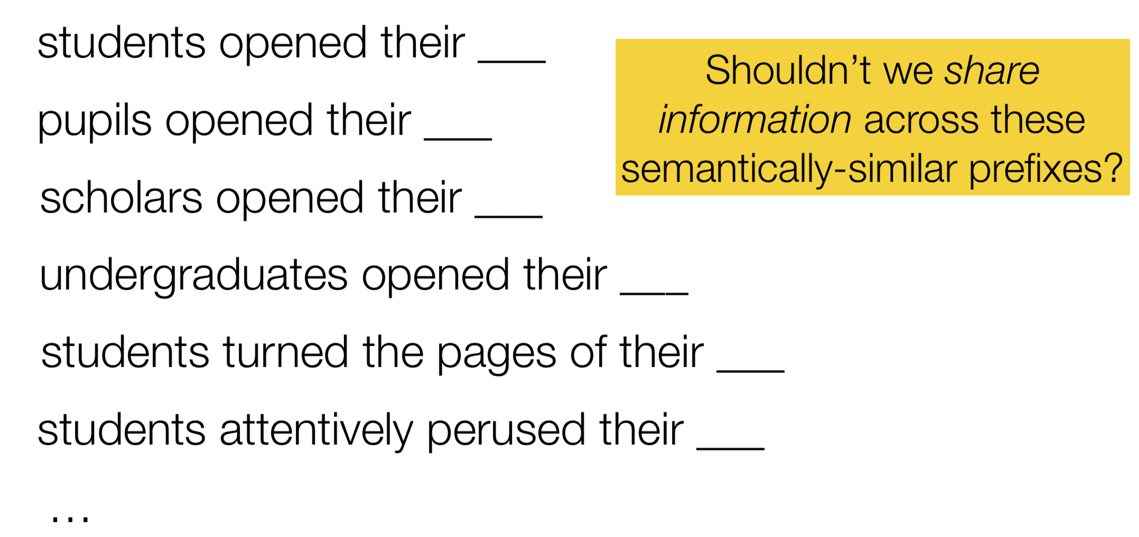
Another issue:
We treat all words / prefixes independently of each other!

Slide 23
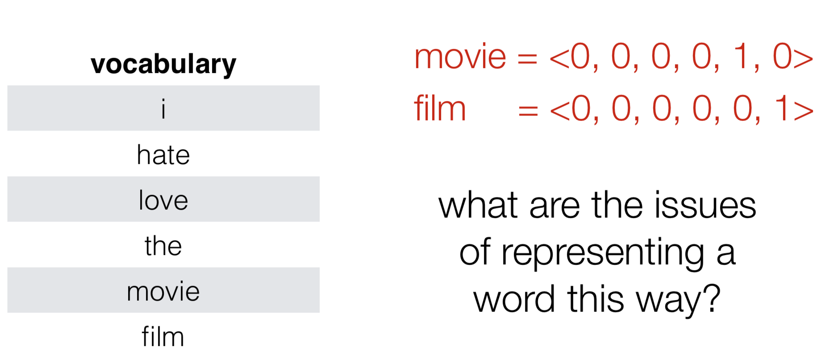
one-hot vectors
represent each word as a vector of zeros with a single 1 identifying the index of the word

Slide 24
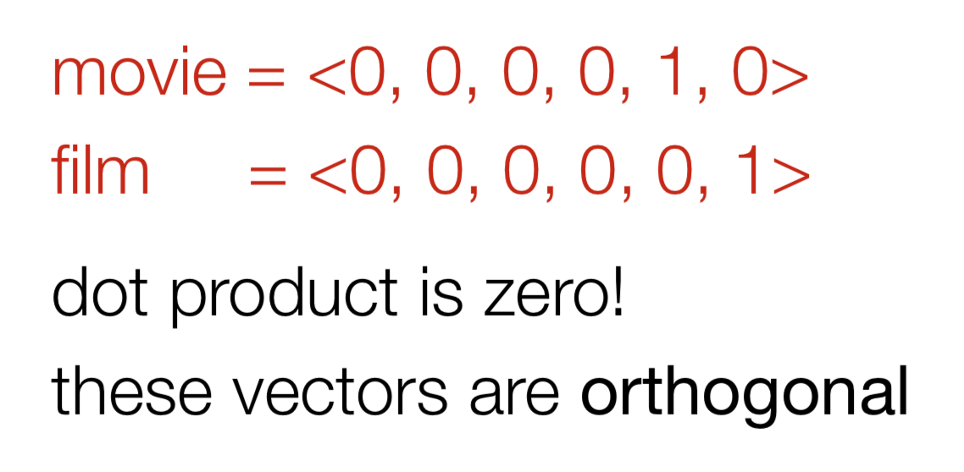
all words are equally (dis)similar!

Slide 25
all words are equally (dis)similar!
What we want is a representation space in which words, phrases, sentences etc. that are semantically similar also have similar representations!

Slide 26
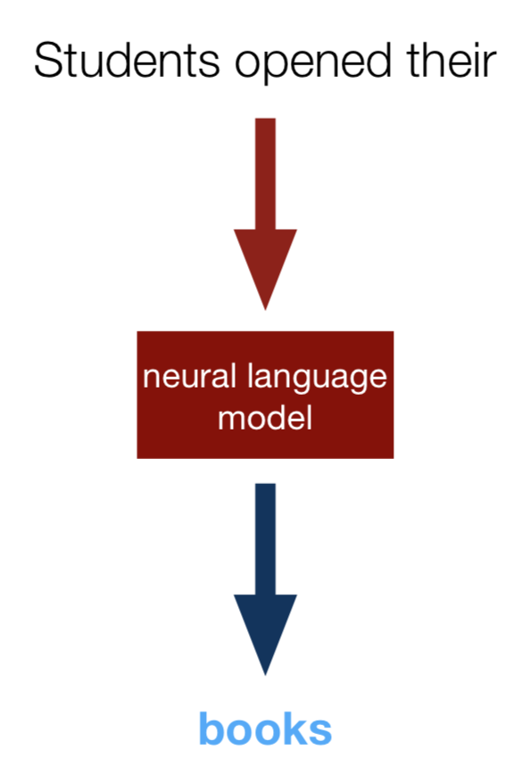
Enter neural networks!

Slide 27
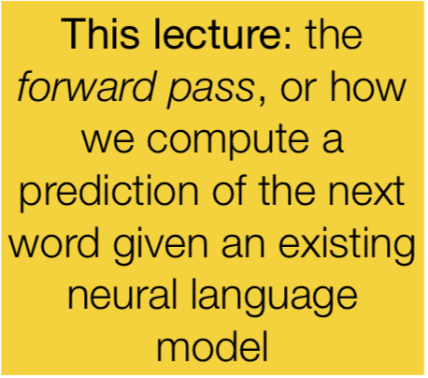
Enter neural networks!

Slide 28
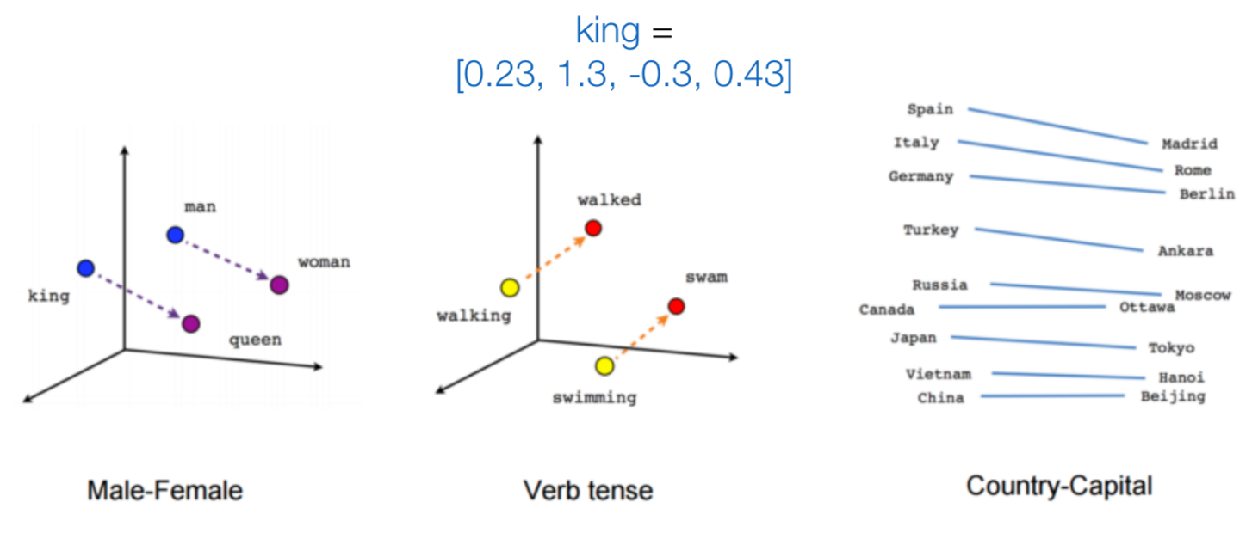
Words as basic building blocks
Represent words with low-dimensional vectors called embeddings

Slide 29
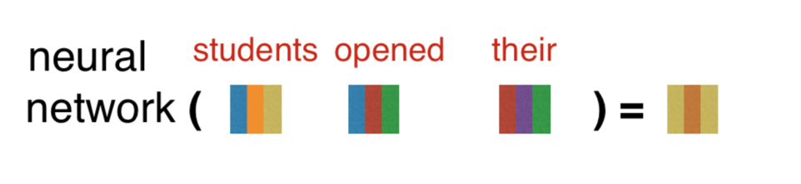
Composing embeddings
Neural networks compose word embeddings into vectors for phrases, sentences and documents.

Slide 30
Predict the next word from composed prefix representation
Predict “books”

Slide 31
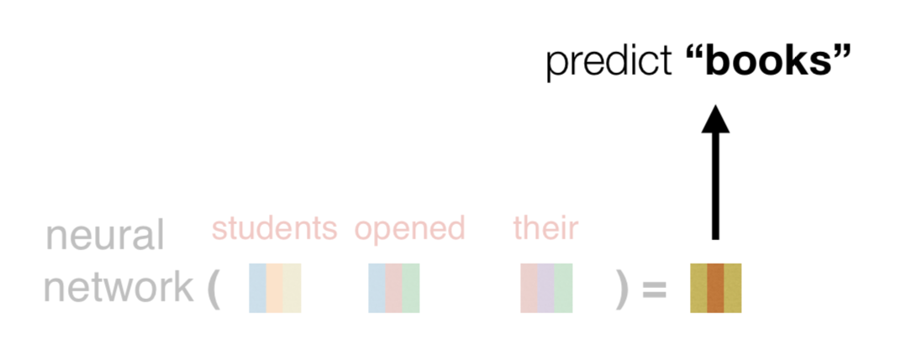
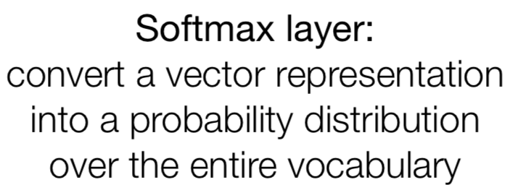
How does this happen? Let’s work our way backwards, starting with the prediction of the next word

Slide 32
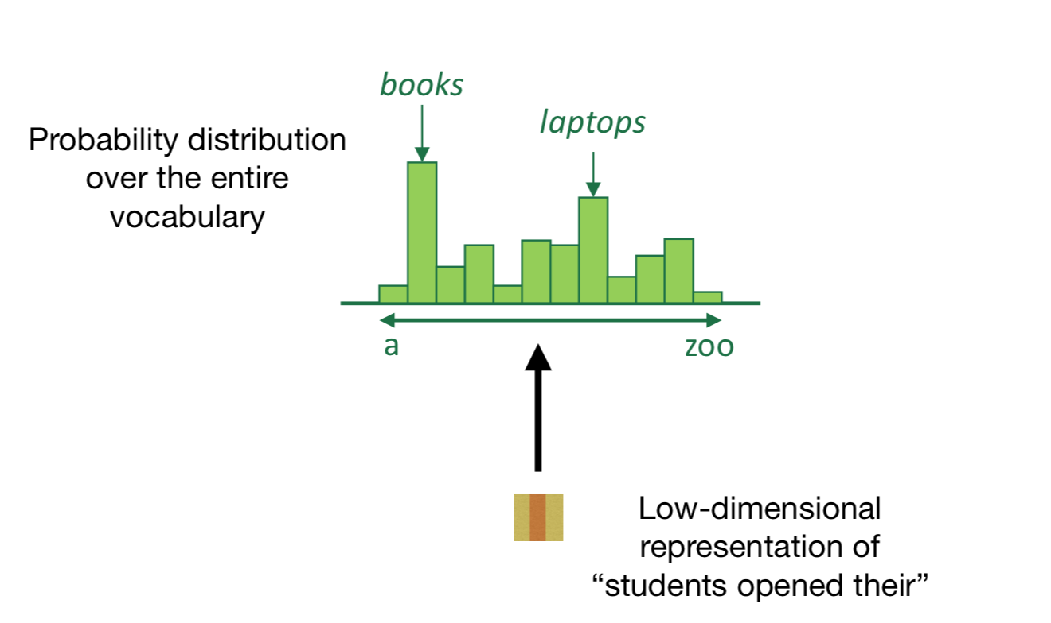

Slide 33
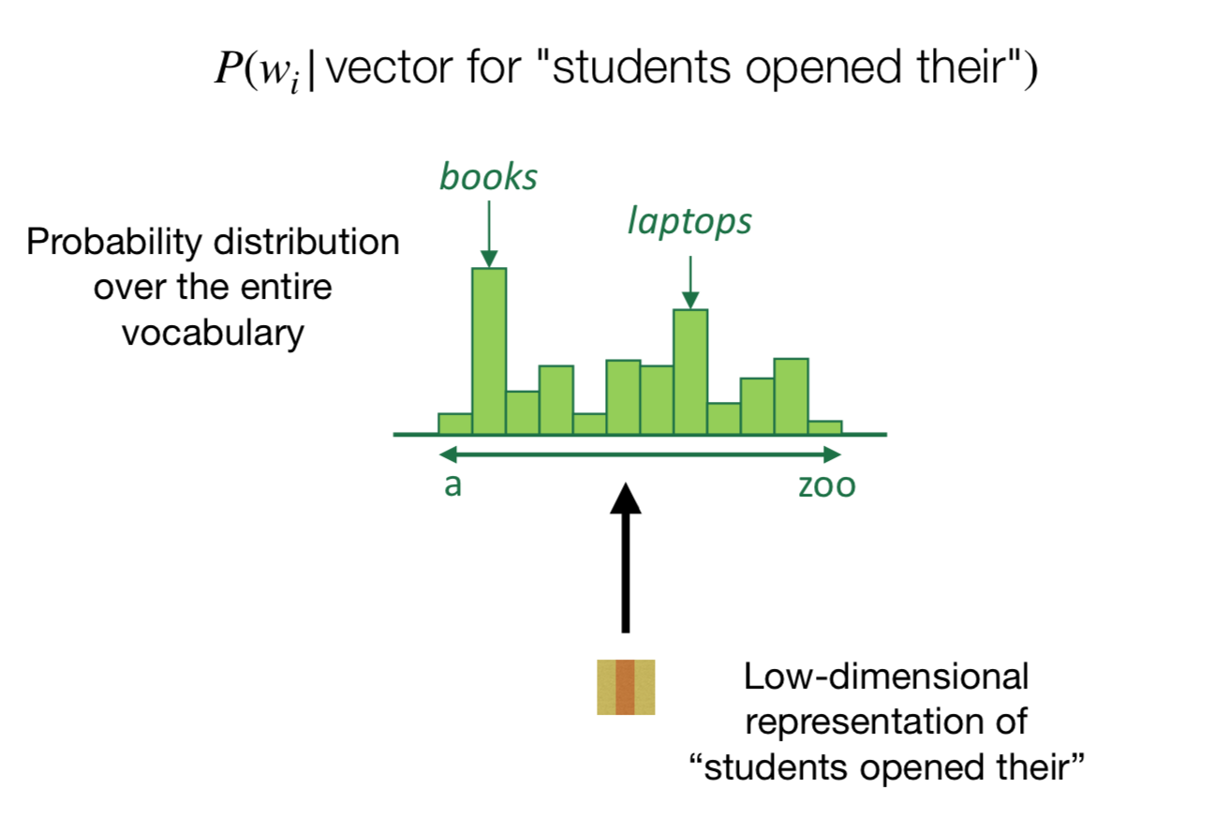

Slide 34
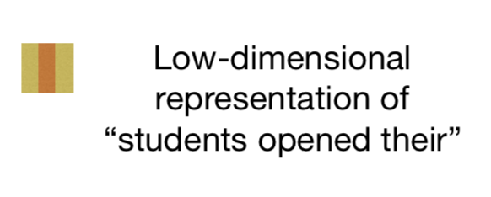
Let’s say our output vocabulary consists of just four words: “books”, “houses”, “lamps”, and “stamps”.

Slide 35
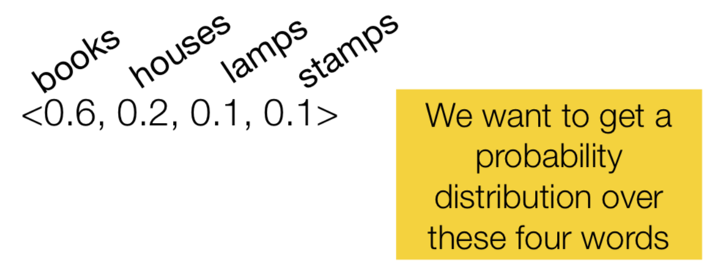
Let’s say our output vocabulary consists of just four words: “books”, “houses”, “lamps”, and “stamps”.

Slide 36
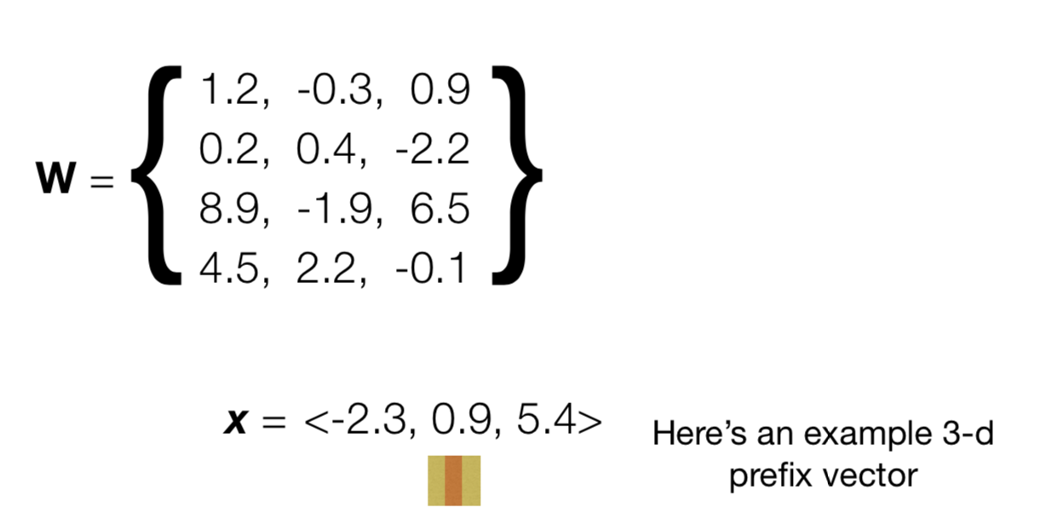

Slide 37
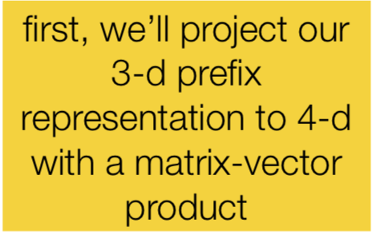

Slide 38
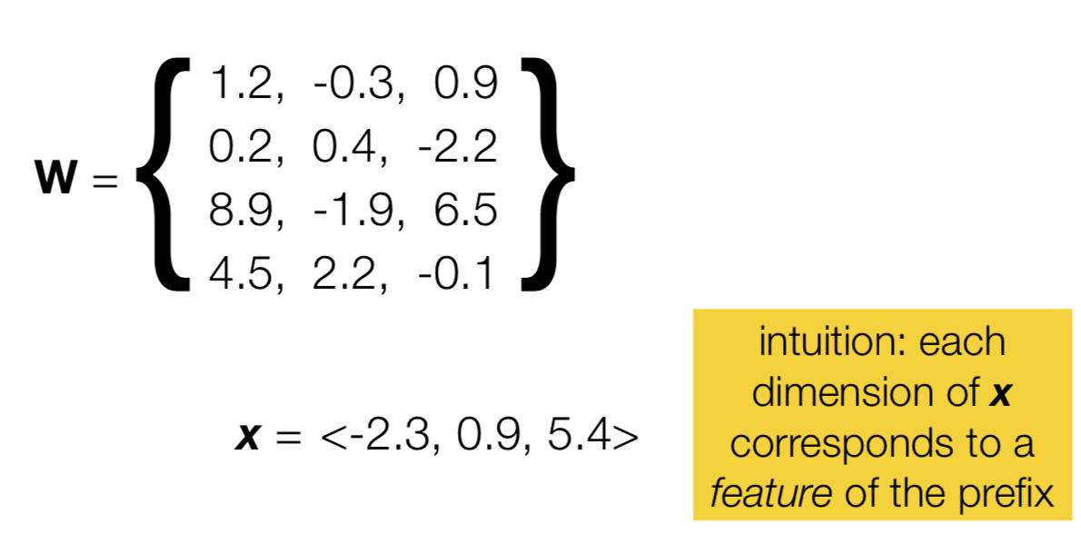

Slide 39
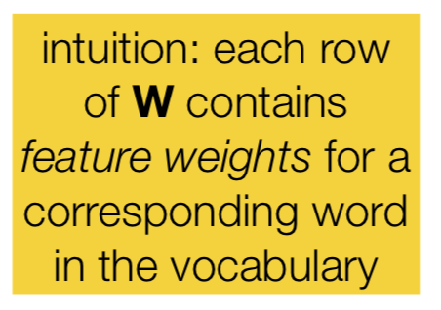

Slide 40
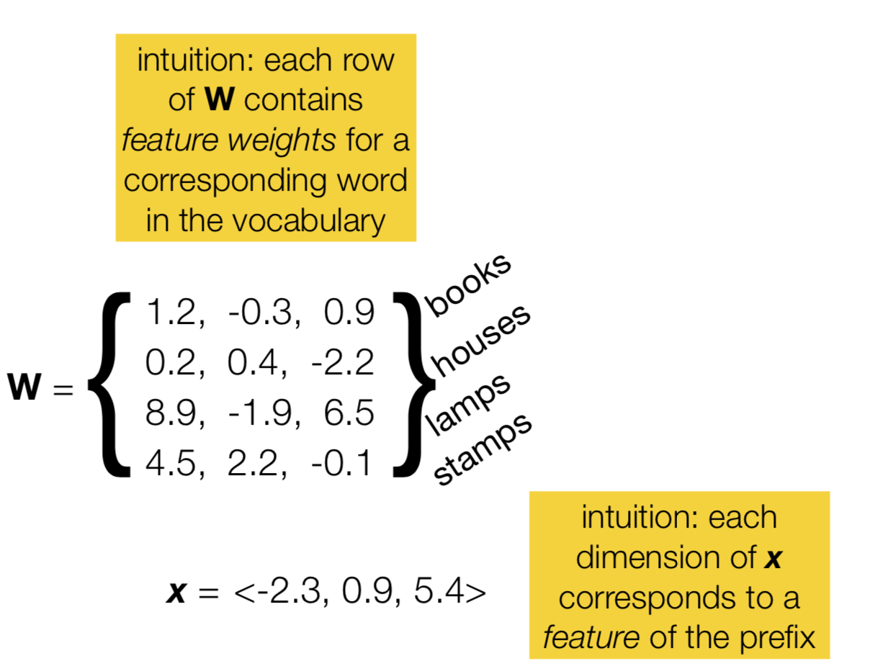

Slide 41
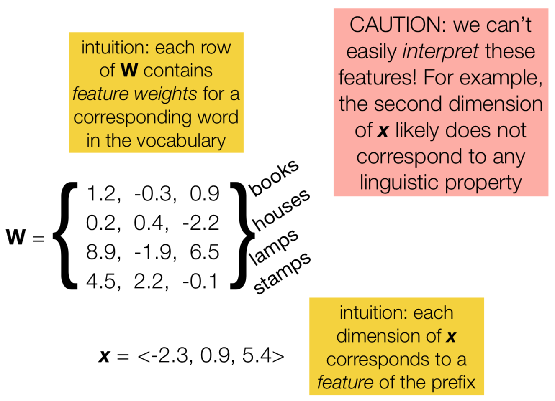

Slide 42
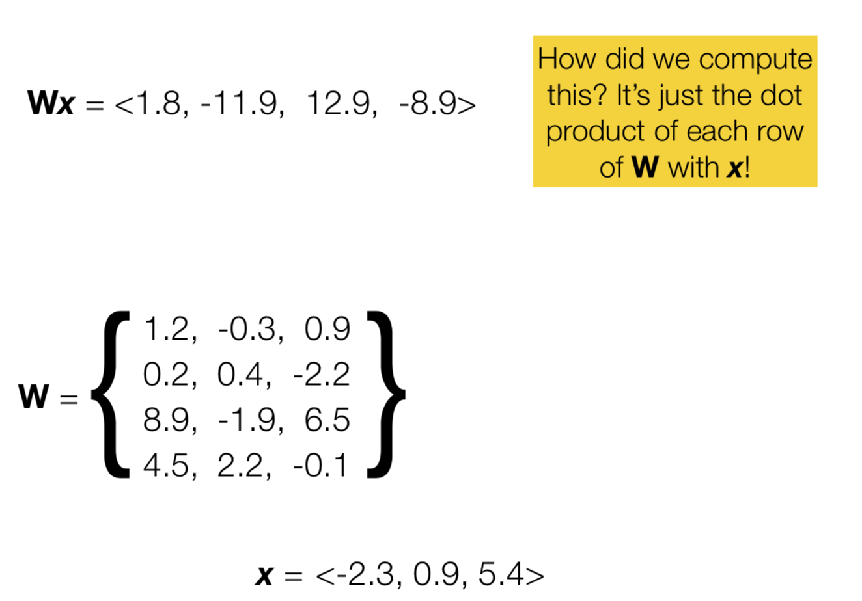

Slide 43
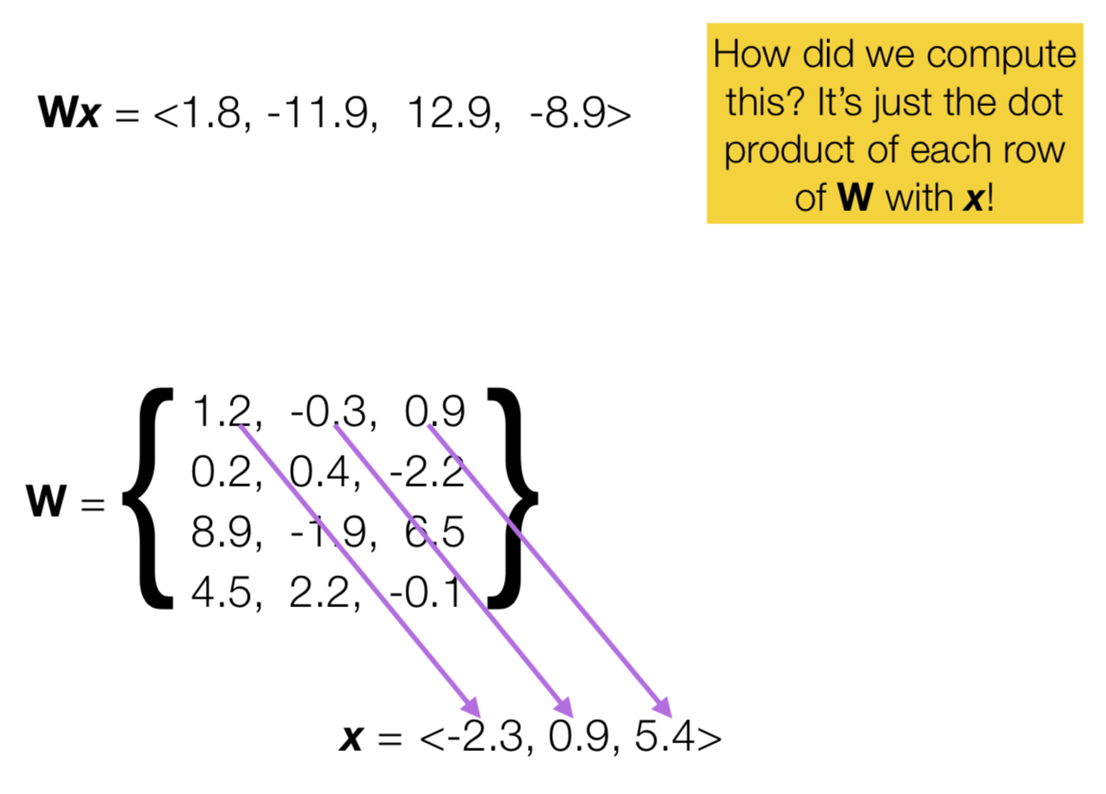

Slide 44
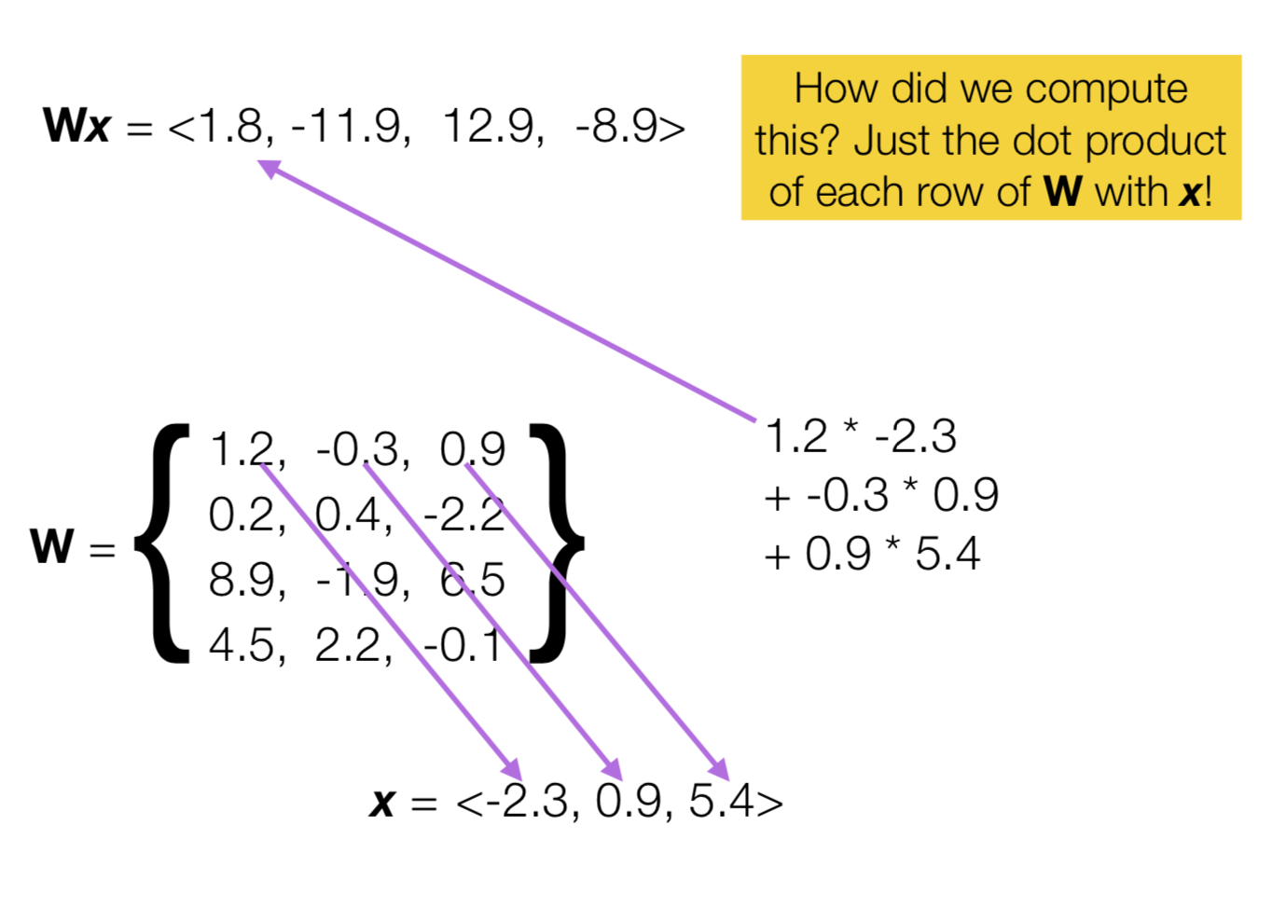

Slide 45
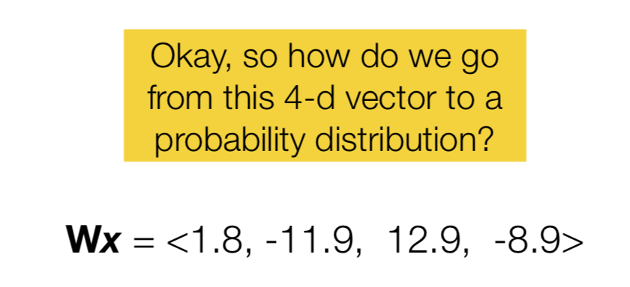

Slide 46
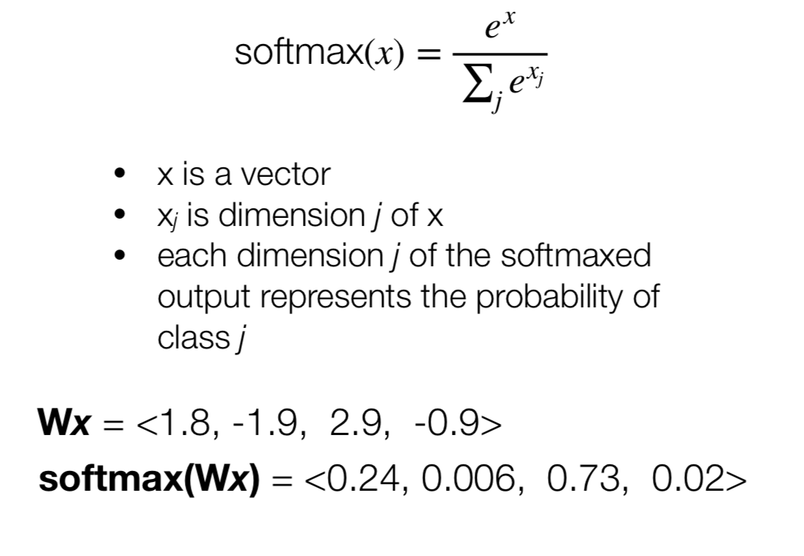
We’ll use the softmax function!

Slide 47
To sum up
Given a d-dimensional vector representation x of a prefix, we do the following to predict the next word:
Project it to a V-dimensional vector using a matrix-vector product (a.k.a. a “linear layer”, or a “feedforward layer”), where V is the size of the vocabulary
Apply the softmax function to transform the resulting vector into a probability distribution

Slide 48
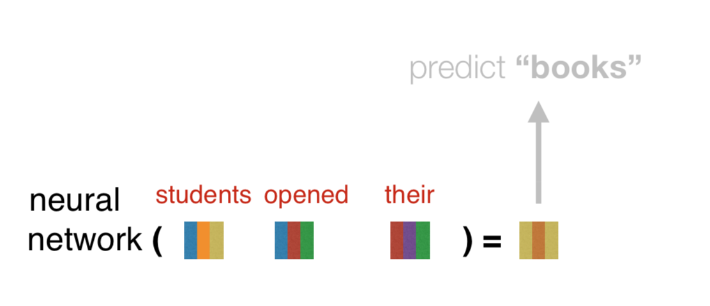
Now that we know how to predict “books”, let’s focus on how to compute the prefix representation x in the first place!

Slide 49
Composition functions
input: sequence of word embeddings corresponding to the tokens of a given prefix
output: single vector
Element-wise functions
e.g., just sum up all of the word embeddings!
Concatenation
Feed-forward neural networks
Convolutional neural networks
Recurrent neural networks
Transformers (our focus in this course)

Slide 50
Let’s look first at concatenation, an easy to understand but limited composition function

Slide 51
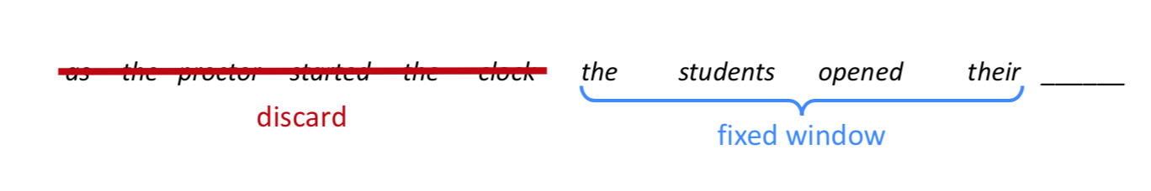
A fixed-window neural Language Model

Slide 52
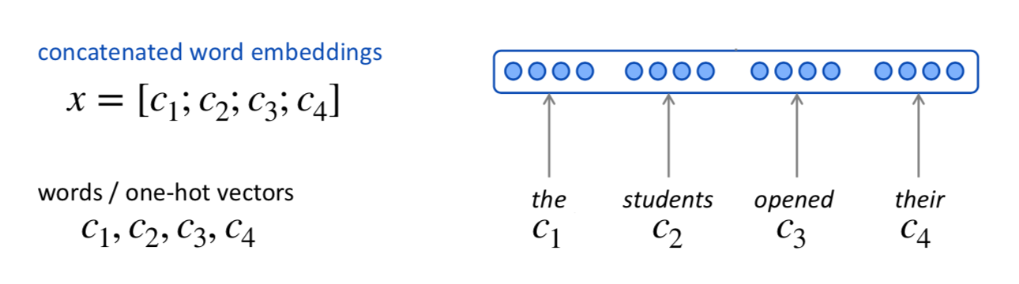
A fixed-window neural Language Model

Slide 53
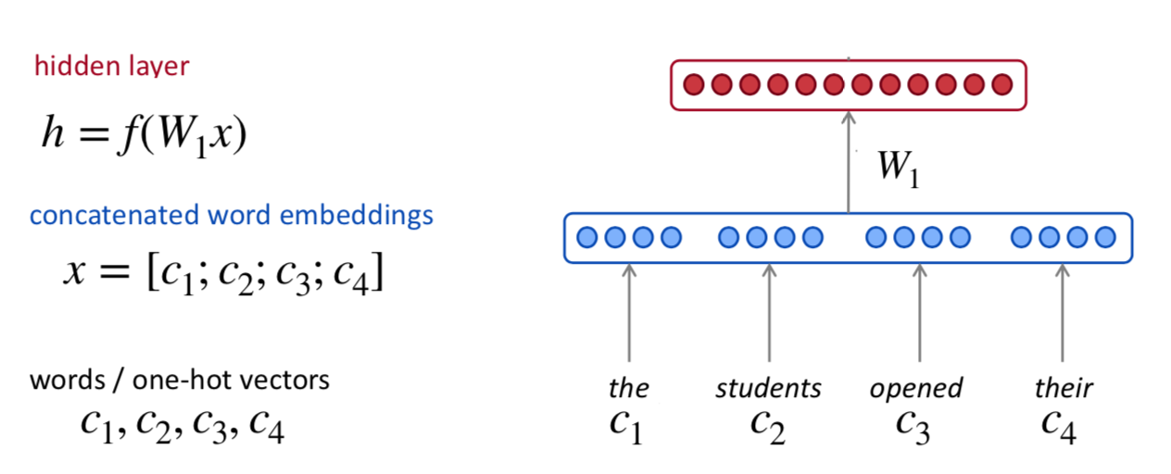
A fixed-window neural Language Model

Slide 54
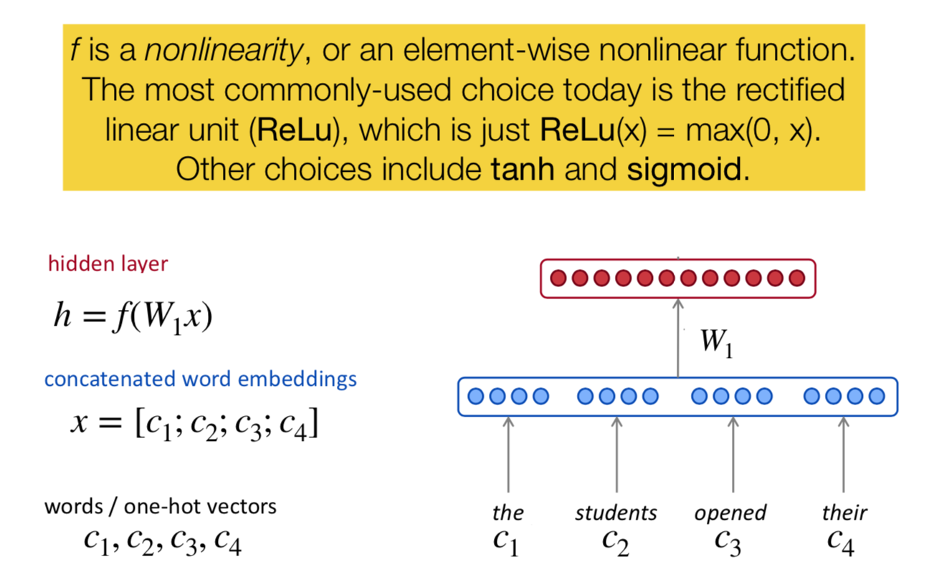
A fixed-window neural Language Model

Slide 55
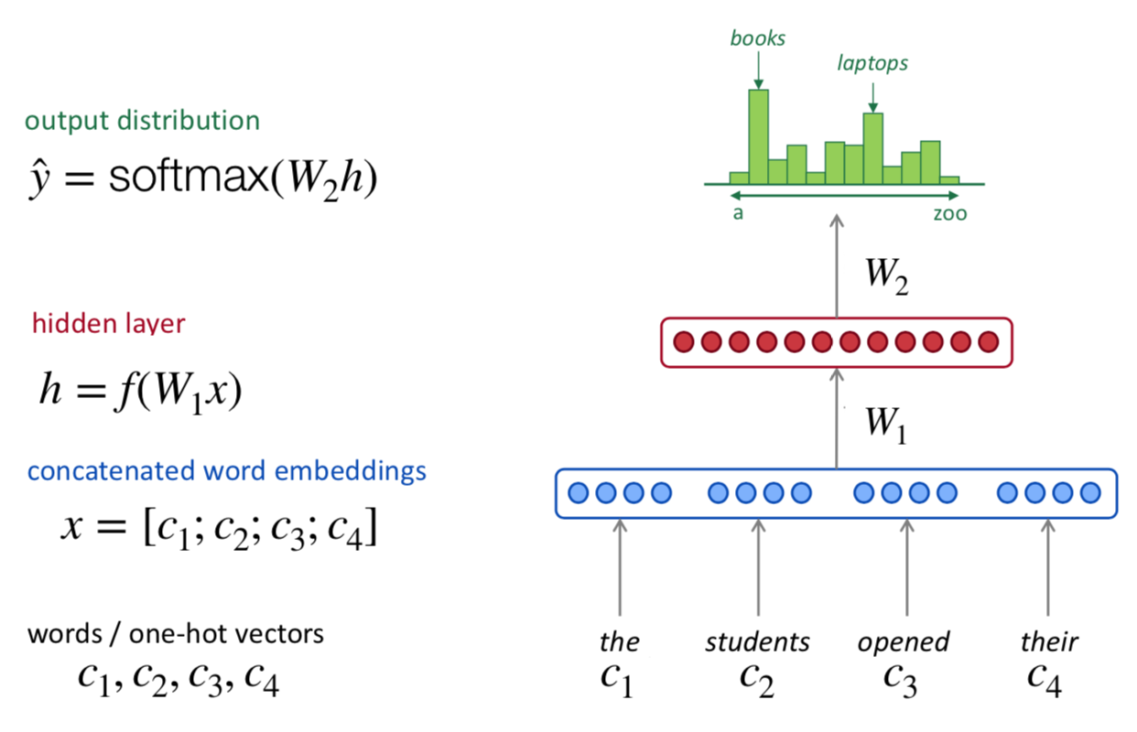
A fixed-window neural Language Model

Slide 56
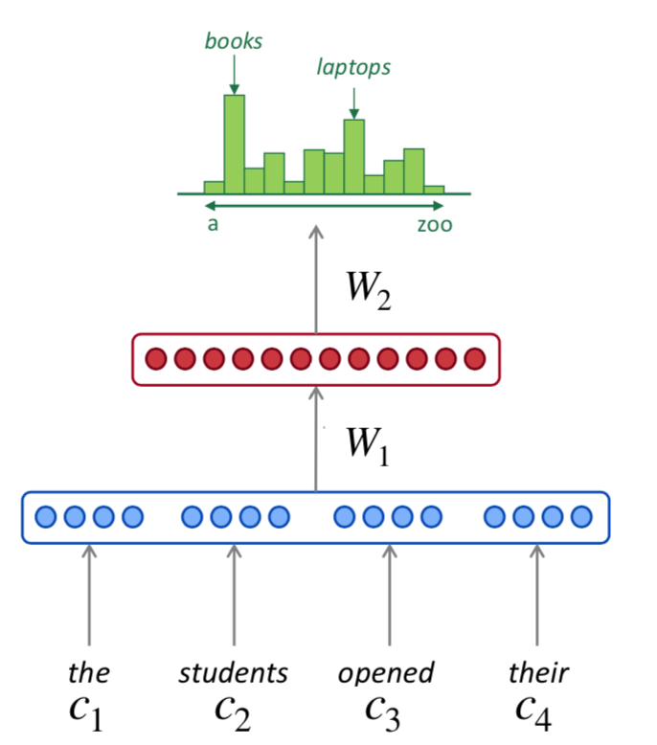
How does it compare to a noraml n-gram language model?
Improvements over n-gram LM:
No sparsity problem
Model size is O(n) not O(exp(n))
Remaining problems:
Fixed window is too small
Enlarging window enlarges w
Window can never be large enough!

Slide 57
Recurrent Neural Networks!

Slide 58
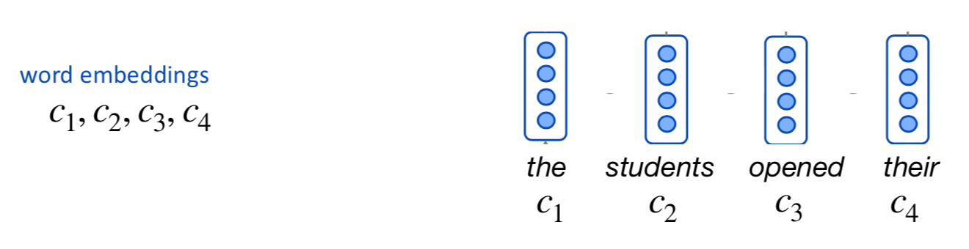
A RNN Language Model

Slide 59
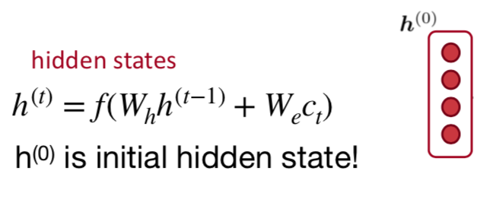
A RNN Language Model

Slide 60

A RNN Language Model

Slide 61

A RNN Language Model

Slide 62

A RNN Language Model

Slide 63

A RNN Language Model

Slide 64



A RNN Language Model

Slide 65

Why is it good?
RNN Advantages:
Can process any length input
Model size doesn’t increase for longer input
Computation for step t can (in theory) use information from many steps back
Weights are shared across timesteps → representations are shared
Remaining Disadvantages:
Recurrent computation is slow
In practice, difficult to access information from many steps back

Slide 66
Next session
We will focus on word embeddings

